Slide 1
TEAM MEMBERS
SIDDHANT PRATAP SINGH (leader)
AYUSHMAN SINGH
AYUSH KUSHWAHA
SHUBHAM GAUD
TEAM ERROR

Slide 2
PROBLEM STATEMENT
FAKE NEWS DETECTION: The prevalence of false information in today's digital environment is a serious threat to information accuracy and integrity, resulting in misinformation spreading widely and eroding public confidence in media outlets , and leads to trust deficit among different communties.

Slide 3
Introduction
Workflow
Idea details
Technology Stack
Advantages
Prototype
Content
Real world application

Slide 4
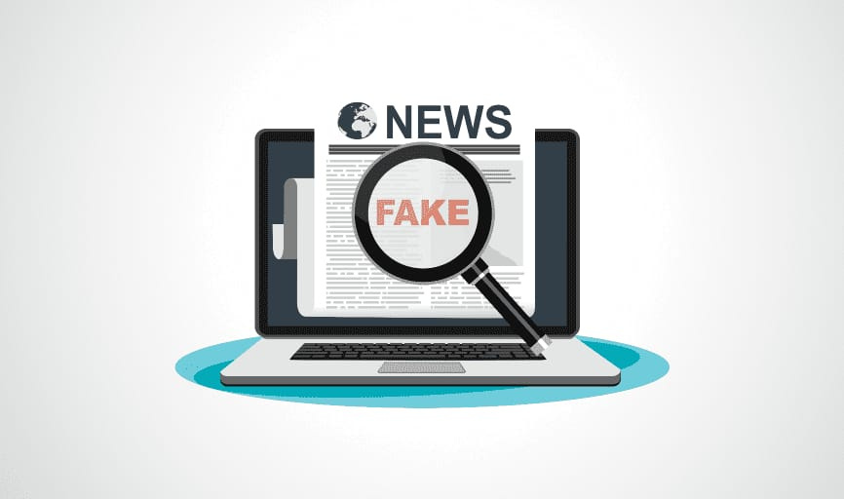
Introduction
Fake news refers to disinformation or false information presented as factual news, typically through traditional news outlets, social media, websites, or other means of communication.
Fake news is intentionally created to deceive or mislead its audience, often with the aim of promoting a particular agenda, causing confusion, or generating clicks or views for financial gain. It can take various forms, including fabricated stories, misleading headlines, altered images or videos, and out-of-context information.
The spread of fake news can have serious consequences, including the erosion of trust in journalism, the polarization of society, and the dissemination of inaccurate or harmful information.
It is essential to be vigilant and critical when consuming news and to verify the credibility of sources to combat the spread of fake news.

Slide 5
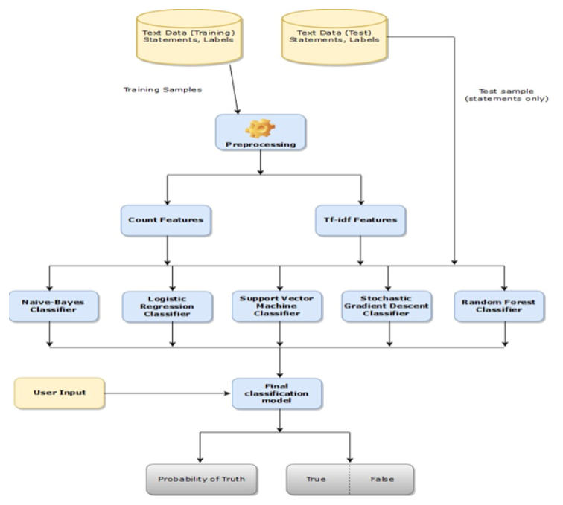
DESIGN(FLOW OF MODULE)

Slide 6
Idea Details
Creating a web based portal that can detect whether a particular news is real or
fake.
On that basis it will give the result-
If the probability of news to be real is between 60% to 80% then the portal will
show that the news may or may not be real.
If the probability of news to be real is below 60% the the portal will say that the news
fake.
If the probability of the news to be real is above 80% the the portal will say that
the news is real.
This will help to avoid misinformation from spreading.

Slide 7


TECHNOLOGY STACK

Slide 8
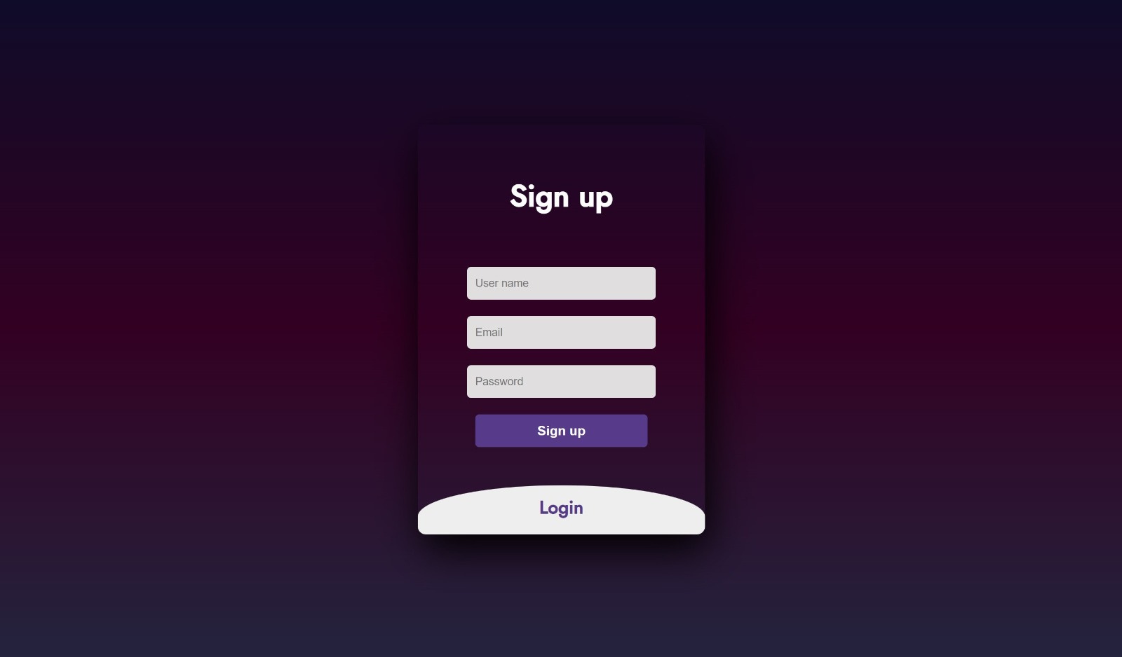
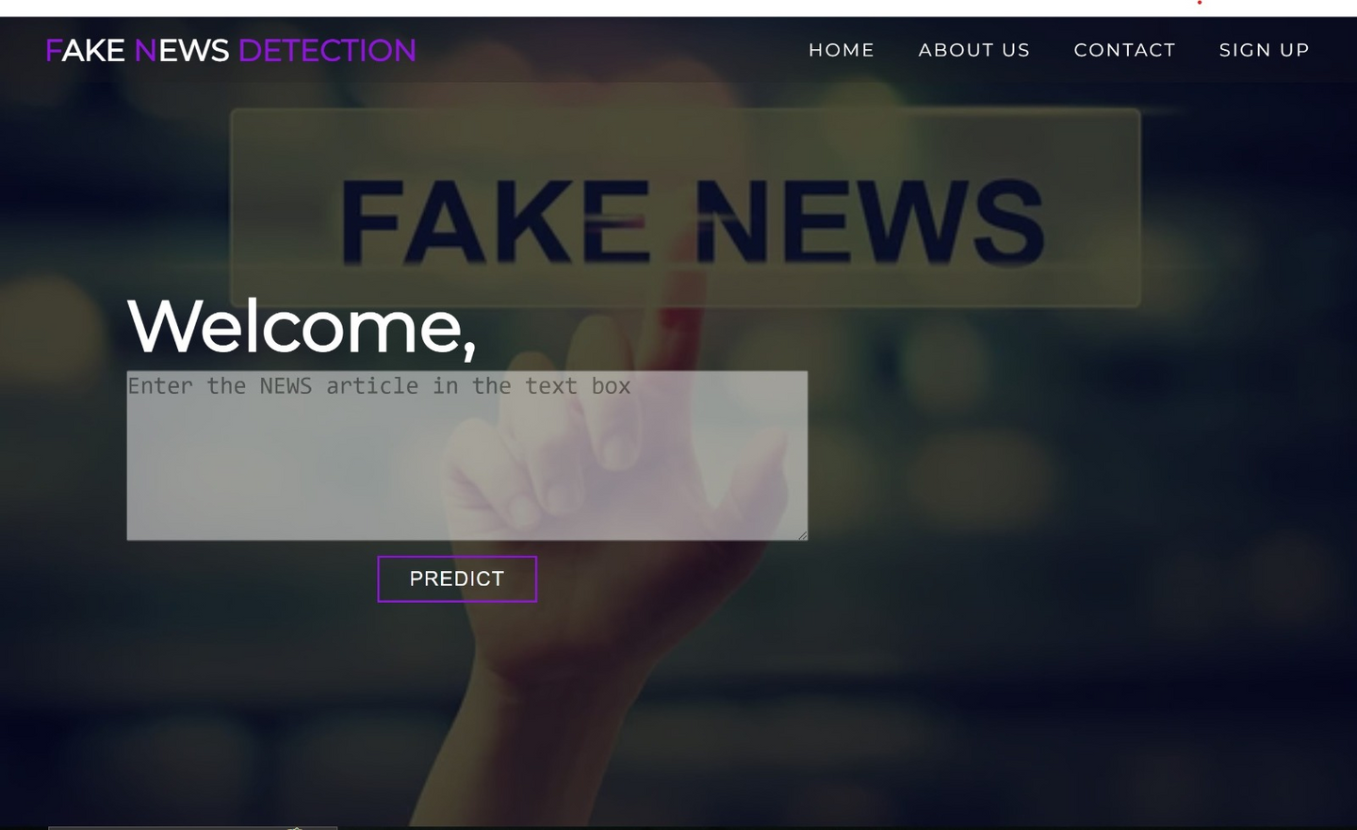
PROTO TYPE

Slide 9

Advantages
Rumor classification
Support for Responsible Journalism
Promotion of Critical Thinking and Media Literacy
Preservation of Trust and Credibility

Slide 10
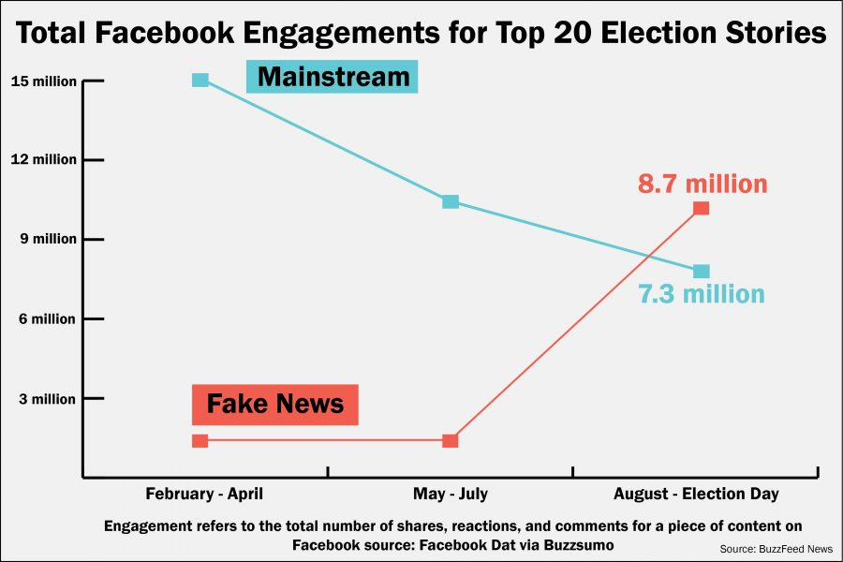
REAL WORLD APPLICATIONS
ELECTIONS
FAKE JOB RACKETS
CHECKING THE CREDIBILITY OF NEWS LINKS RECIEVED ON SOCIAL MEDIA.
FAKE MEDICAL NEWS MESSAGES.

Slide 11
THANK YOU

